Slide 1
Fundamentals of Advising & Registration
Pre-Orientation advising module for new students.
For questions please contact us at: askanadvisor@isu.edu or (208) 282-3277

Slide 2
Welcome to the Fundamentals of Advising and Registration (FAR) online session!
Please review these slides in preparation for New Student Orientation (NSO) where you will be assisted with course registration. We have designed this pre-session to provide you an overview of terminology, processes, and best practices as you begin your college career. Feel free to click on the various links throughout this session to find more information.

Slide 3
The FAR is divided into five sections:
1. University Structure
2. Degree Requirements
3. First Semester Schedule
4. Student Success Resources
5. BengalWeb Resources

Slide 4
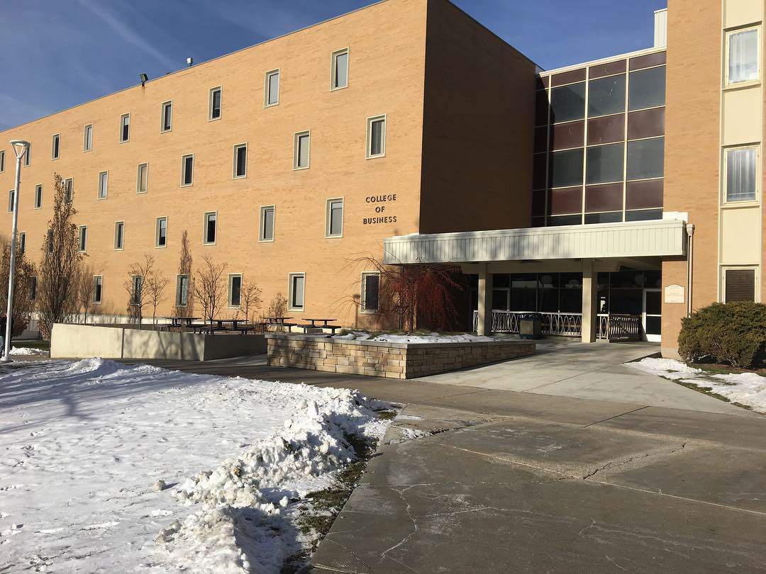
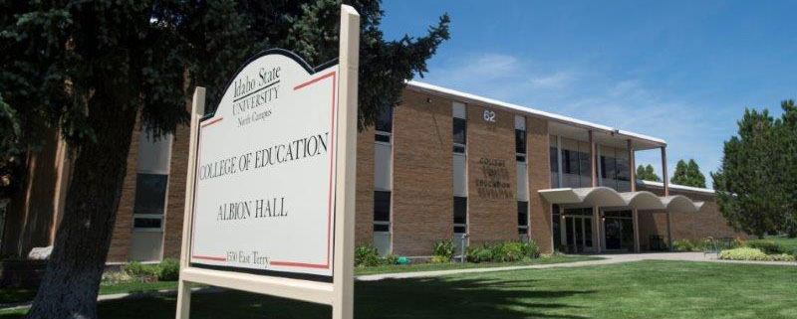
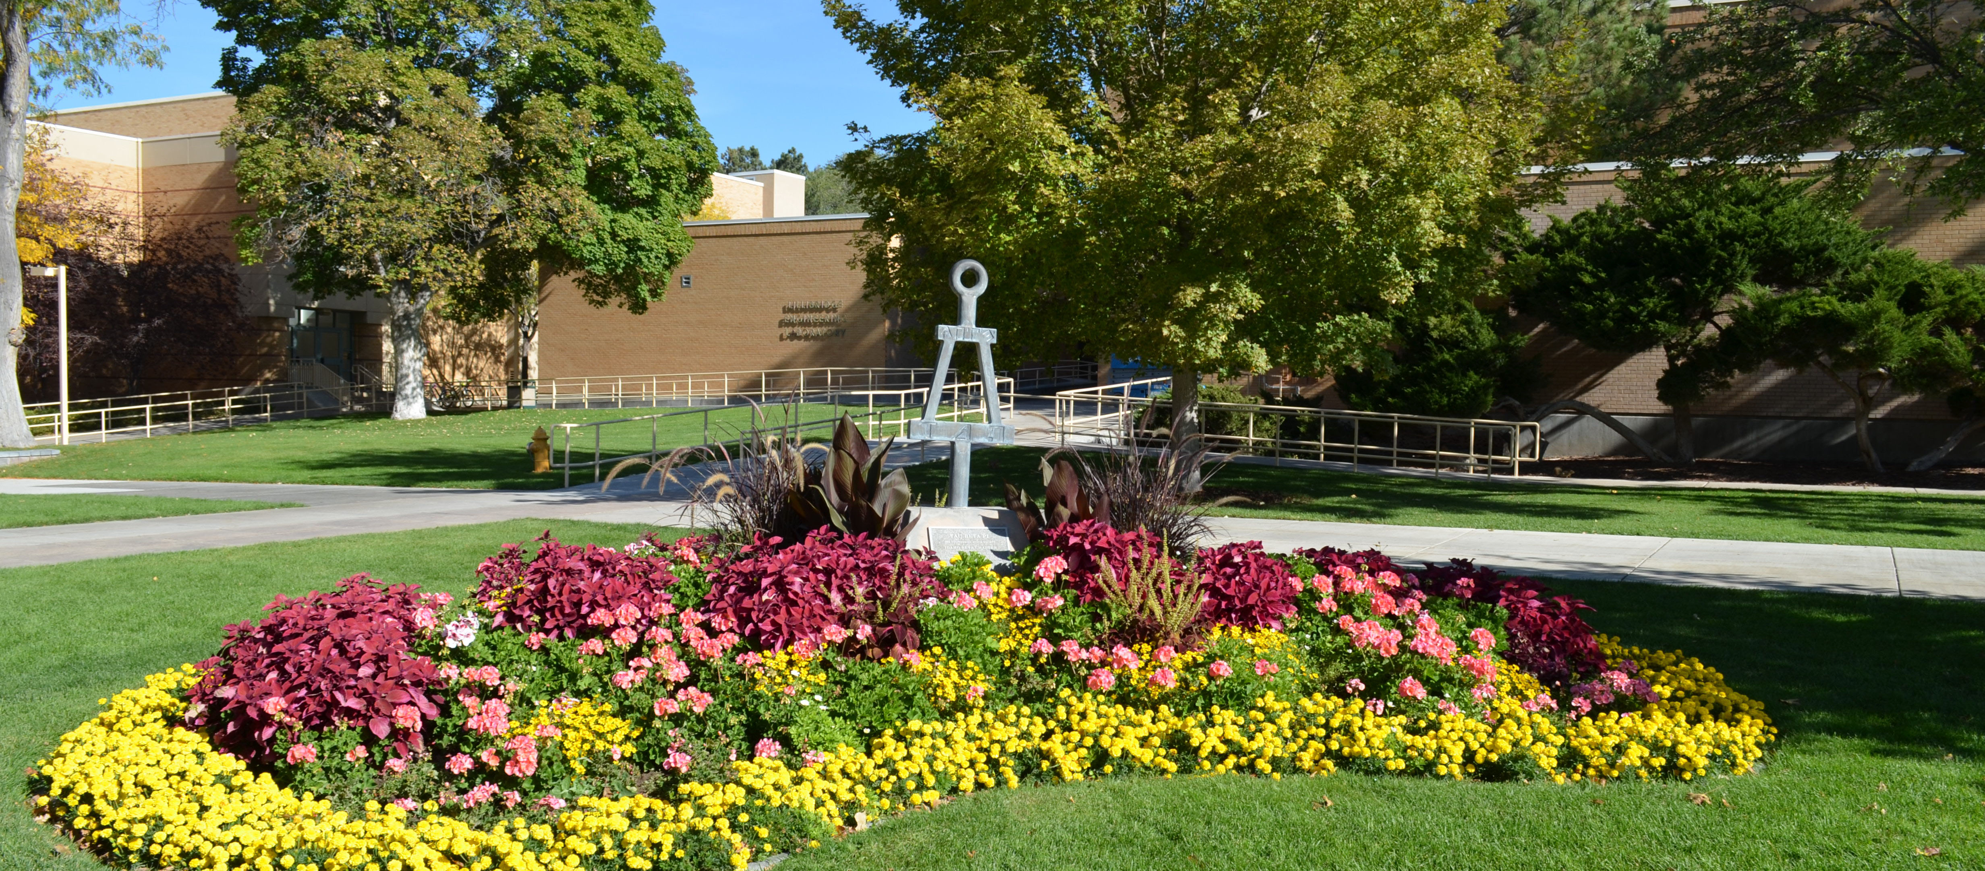
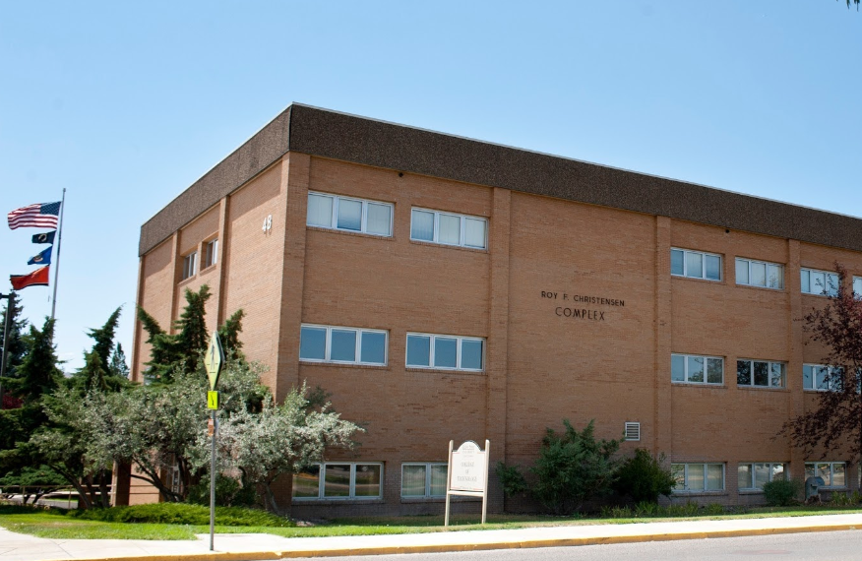
Section 1: University Structure
College of Arts and Letters
College of Business
Idaho State University has 7 academic colleges. Each major at ISU is housed in one of these colleges.
Find your college and major in the Academic Catalog http://coursecat.isu.edu/undergraduate/programs/
Visit your college’s website to learn about the faculty, resources, and opportunities available to you.
https://www.isu.edu/academics/
College of Education
Division of Health Sciences
The Division of Health Sciences houses 4 colleges:
College of Health
College of Pharmacy
College of Science & Engineering
College of Technology

Slide 5
Undergraduate Majors and Minors
Students choose a major (and minor, if desired) upon admission to ISU. A major is the field of study in which the student has chosen to focus. A minor (optional at ISU) is a secondary field of study.
A major may be a bachelor’s degree (4 year) or an associate’s degree (2 year) with one of the degree designations below:
Bachelor of Arts (BA) or Bachelor of Science (BS)
Bachelor of Fine Arts (BFA)
Bachelor of Music (BM)
Bachelor of Business Administration (BBA)
Bachelor of Applied Science (BAS)
Bachelor of Science in Health Science (BSHS)
Associate of Arts (AA) or Associates of Science (AS)
Associate of Applied Science (AAS)

Slide 6
Investigating Your Major
ISU has several helpful resources for students who want to find out more about their chosen major or explore other available major options:
Online Career Planning, Focus 2 https://www.isu.edu/career/focus2/
ISU Career Center https://www.isu.edu/career/
ISU Center for New Directions https://www.isu.edu/cnd/
Academic Advisors https://www.isu.edu/advising/
Tour our College of Technology programs https://www.isu.edu/tech/

Slide 7
Section 2: Degree Requirements
All degrees have minimum requirements that must be met before a student may graduate.
See the complete list here: http://coursecat.isu.edu/undergraduate/degreerequirements/
A minimum of 120 credit hours.
A minimum of 36 Upper Division* credit hours.
A minimum of 36 General Education credits.
*Upper Division credits are courses beginning with
3000 or 4000

Slide 8
What makes up a degree?
SAMPLES:
BS Biology
Type of course Credits
Major 55
General Education 40
Free Electives 15
120
BS Nuclear Engineering
Type of course Credits
Major 90
General Education 37
Free Electives 0
127
Major courses (30 to 90 credits)
All required courses that meet department and discipline accreditation regulations.
General Education (min. 36 credits)
A set of courses that provide a breadth of knowledge on conventional and traditional subject matter.
Free Electives (0 to 90 credits)
Any course numbered 1000 to 4999 that is not required. Free Electives may be needed to reach the required 120 credit minimum.

Slide 9
Which classes do I take for my major? You can find your major requirements online:
ISU Undergraduate Catalog http://coursecat.isu.edu/
Major Academic Plan (MAP) https://www.isu.edu/advising/maps/
Degree Works in BengalWeb https://bengalweb.isu.edu/

Slide 10
Degree Works
A Degree Works audit is a review of past, current and planned coursework that provides information on completed and outstanding program requirements necessary to complete a degree.
The audit is divided into block requirements such as Degree, General Education, and Major Requirements. Each block works like a checklist with boxes that are programmed to be checked when a requirement is met.
Degree Works
Degree Works: "What If" feature

Slide 11
General Education Objectives
are a set of courses that provide a breadth of knowledge beyond your major focus.
ISU requires a minimum of 36 credits taken from the 9 Objective areas.
Double counting. Where possible take courses that fulfill both a General Education course and a Major course. (i.e. FIN 1115 covers Objective 7/8 and is a core course for Business programs)
Objective Areas
Written Communication
Oral Communication
Mathematical Ways of Knowing
Humanistic and Artistic Ways of Knowing
Scientific Ways of Knowing
Social and Behavioral Ways of Knowing
Critical Thinking
Information Literacy
Cultural Diversity

Slide 12
Section 3: First Semester Schedule
To finish your bachelor’s degree in four years, complete 30 credits each year.
Take 15 credits each fall and spring semester
OR
Take 12 credits fall, 12 credits spring,
and 6 credits in summer

Slide 13
Recommended First Semester Courses:
English
3 or 4 credits
Learn to meet college level writing and research expectations by taking English in your first and second semester.
Math
3, 4 or 5 credits
Do not delay taking math. Math and English are often required to progress in your major.
Major course
3 credits
Get started on your major classes and see if the class content is what you expected.
ISU 1199
3 credits
Learn how to be a successful college student.
Free Electives
Learn to swim or ski or choose a course simply because it interests you!

Slide 14
Math Placement
Students place into math courses by achieving specific scores on their:
ALEKS
ACT and/or SAT
AP credit
Dual enrollment credit
Scores from these exams place students into math courses up to MATH 1170 (Calculus I).
Math Course Placement Chart

Slide 15
English Placement
Course placement for English is determined by:
High school GPA
ACT and/or SAT
AP Credit
Dual enrollment credit
Students without a high school GPA, ACT, or SAT scores must enroll into ENGL 1101P.
English Course Placement Chart

Slide 16
Section 4: Student Success Resources
#1 Resource - Academic Advising
ISU academic advisors are knowledgeable and friendly professionals who are dedicated to providing you information and guidance regarding all aspects of the undergraduate experience. All incoming freshman will have an assigned academic advisor that will assist and support each student.

Slide 17
#1 Resource - Academic Advising
Your academic advisor will communicate with you mostly by email, to remind you of important deadlines and inform you about relevant university policies.
Please read your ISU email every day.

Slide 18
Free and Confidential Resources
Tutors
https://www.isu.edu/tutoring/
Health Center
https://www.isu.edu/healthcenter/
The Math Center
https://www.isu.edu/tutoring/math-center/
The Writing Center
https://www.isu.edu/tutoring/writing-center/
Student Leadership and Engagement Center
https://www.isu.edu/lead/
Diversity Resource Center
https://www.isu.edu/drc/
https://www.isu.edu/ctc/
https://www.isu.edu/cnd/
Counseling

Slide 19
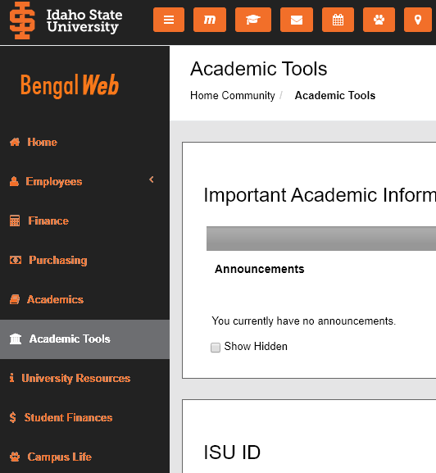
Section 5: BengalWeb Resources
Become Familiar with BengalWeb!
Click on each icon to learn more:
Left-hand Navigation Bar
Moodle
Degree Audit
Email
Calendar
Service Desk
ISU Map
Click on each navigation bar to learn more:
Academic Tools
University Resources
Student Finances
Campus Life

Slide 20
Important Fee Information
Tuition and fees are due the Friday before the first day of the fall, spring, and summer semesters.
Students who have not paid tuition and fees or have not enrolled in a payment plan, will incur late fee charges.
Please Note:
Students who register for ISU courses but ultimately do not attend ISU, must drop their classes in BengalWeb before the tenth day of the semester.
If they do not drop by the deadline, students will be charged full tuition and fees, and will receive failing grades.
Click here to see information on Student Financial Services.

Slide 21
Next Advising Steps:
Make sure all dual enrollment and final High School transcript(s) have been sent to the ISU Office of Admissions.
Come to New Student Orientation and register for first semester courses with your ISU Academic Advisor.

Slide 22
Welcome to ISU!
Let’s ROAR!

